Slide 1
Module 3: Using Files and Directories
Where is my data?
3: Using Files and Directories
4: Editing Text
5: Working with Bash

Slide 2
Contents
From User to Disk
From Pathnames to Disk Blocks
What is a Directory?
Files
Commands
i-nodes
Links
Notes:
In the Linux and Unix world, everything is a seen as a FILE (commands, devices, logs, data and even directories are stored as a file). So, we need to understand what they are and how to use them.

Slide 3
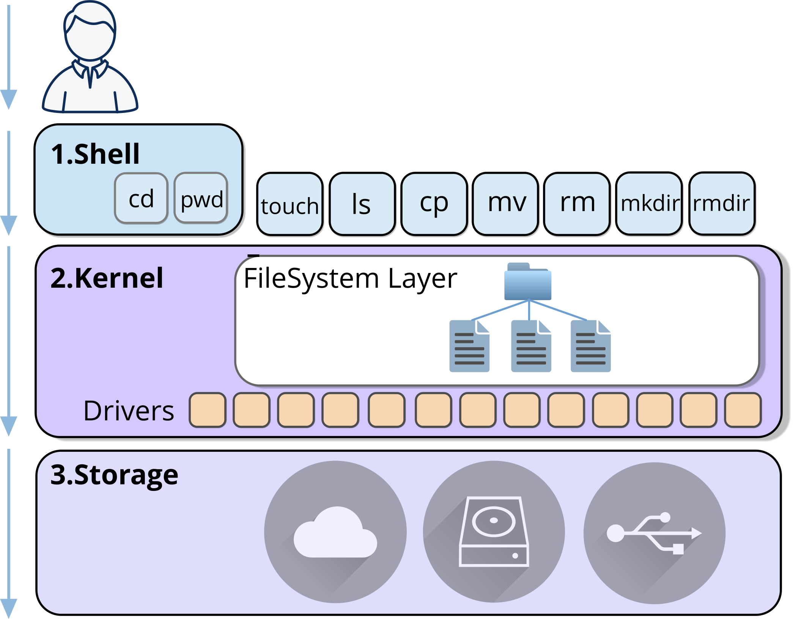
From User to Disk
The shell interprets user commands
The kernel performs the real work
The filesystem layer resolves pathnames
Notes:
When you type a command like cat /etc/passwd, it looks simple.
But the shell itself doesn’t read the file.
It passes the request into the kernel.
Inside the kernel, the filesystem layer resolves the pathname, translates names into inode numbers, and locates the data blocks on disk. Let’s now zoom into that filesystem layer and see what’s really happening when a pathname is resolved.

Slide 4
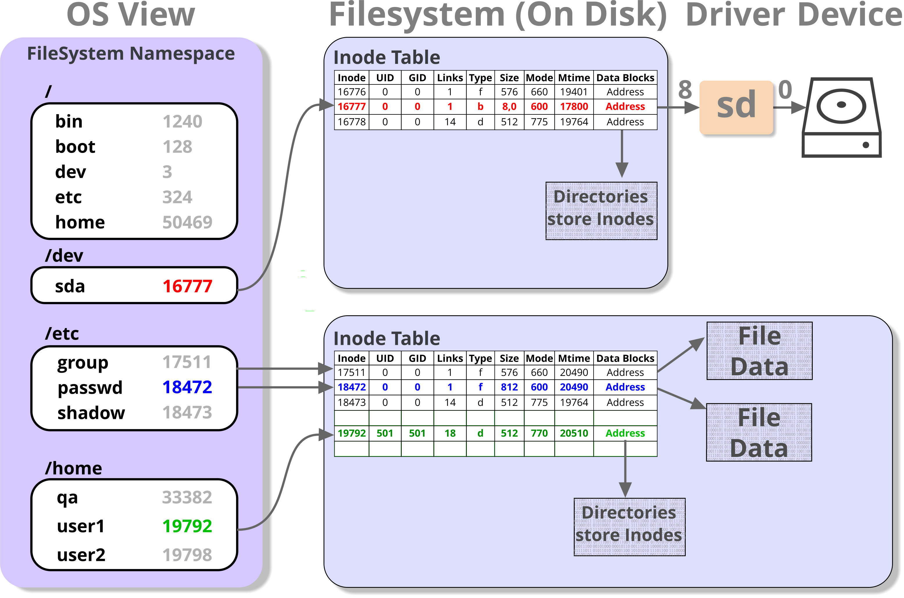
From Pathnames to Disk Blocks
Directories map filenames to inode numbers
Inodes store metadata and block addresses
Data blocks store file contents
Notes:
In Linux, almost everything is treated as a file. This includes regular files, directories, hardware devices, and even certain aspects of system information.
Directories are simply special types of files. Rather than storing user data, they store references to other files and subdirectories, forming the familiar hierarchical filesystem structure.
Every file and directory is represented internally by an inode (index node). The inode stores the file’s metadata, including:
File type (regular file, directory, symbolic link, device, etc.)
Ownership and permissions
File size and timestamps
Pointers to the actual data blocks on disk
Importantly, directories do not store file data. They store mappings between filenames and inode numbers. The inode then points to the file’s data blocks. This design allows Linux to manage files efficiently and consistently.
Even hardware devices and system information are exposed through this same model. For example, /dev/sda represents a disk device, and /proc/cpuinfo exposes CPU details.
Because they appear as files, they can be accessed using the same tools and commands as regular files, providing a uniform interface to the entire system.

Slide 5
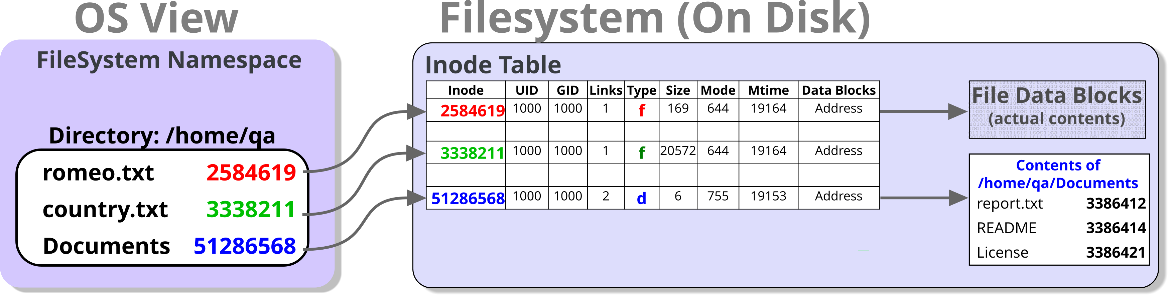
What is a directory?
A directory is a special type of file
It stores filename inode mappings
It does not store file data
Notes:
Data and programs are stored in files. Files are organised into directories, forming a hierarchical (tree-like) structure.
A directory is a special type of file. It does not store file data, it stores filename → inode mappings that describe other files. Directories can contain both files and other directories. This allows the filesystem hierarchy to extend to many levels.
There can be many files and directories within a single directory, and the hierarchy can grow as deep as required by the system and storage capacity.
UNIX/Linux extends the concept of a file further than many operating systems:
Everything is treated as a file.
Physical devices are accessed through special filenames within the filesystem (for example, entries under /dev). In many implementations, system memory, kernel information, and even running processes are also exposed through the filesystem (for example, under /proc and /sys).

Slide 6
Naming Files and Directories
File and directory names may contain any character except /
Use letters, numbers, dots (.), dashes (-) and underscores (_)
Avoid spaces and shell special characters where possible
Maximum name length is typically 255 characters
Names beginning with a dot (.) are hidden by default
Hidden files and directories are displayed using ls –a
In Linux and UNIX, file extensions (such as .txt or .pdf) are naming conventions only
255 chars
.this_is_@_very_l0ng_FILE.and.DIR_n4me.pdf
.pdf
Dots and underscores are valid characters
Recommended characters: letters,
numbers, dots and underscores
No filetype!
Notes:
Linux allows file and directory names to contain almost any character except the forward slash (/), which is reserved as the pathname separator. Although spaces and special characters are permitted, they can make commands more difficult to enter and may require quoting or escaping. For this reason, it is recommended to use letters, numbers, dots (.), dashes (-) and underscores (_) when naming files and directories. Names beginning with a dot (.) are treated as hidden and are not displayed by a normal ls command unless the -a option is used.
Unlike Windows, Linux does not rely on filename extensions such as .txt, .pdf or .jpg to determine the type of a file; extensions are simply naming conventions that help users identify file contents.

Slide 7
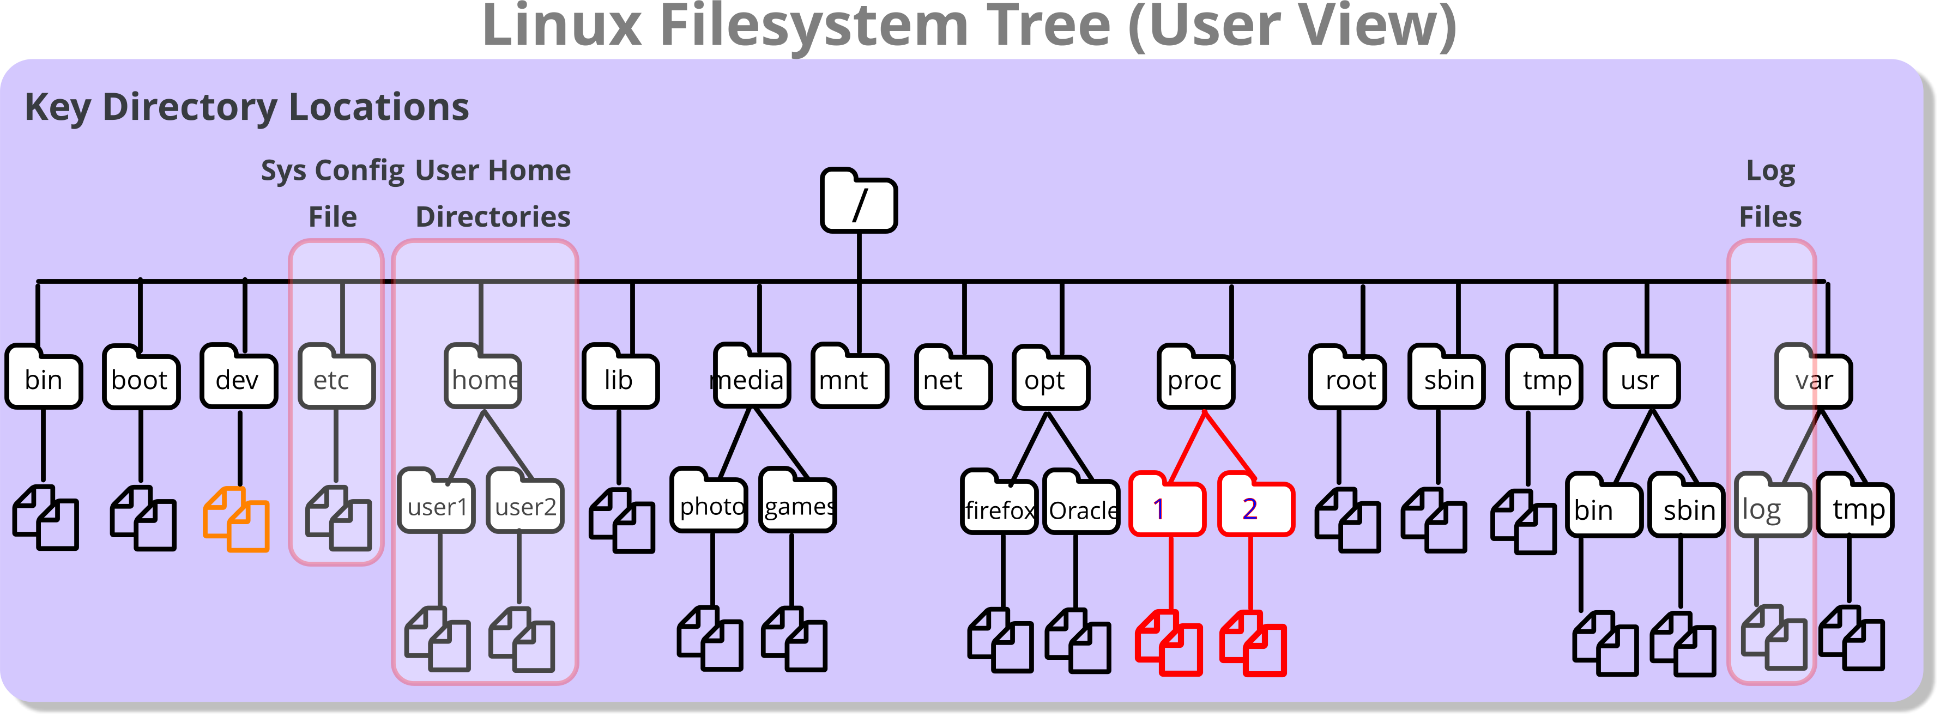
The Linux / Unix filesystem hierarchy
The filesystem appears as a single tree rooted at /
Users navigate this hierarchy using pathnames
Different branches may reside on separate disks or partitions
The layout follows the Linux Filesystem Hierarchy Standard (FHS)
Notes:
The Linux filesystem presents a single unified directory tree rooted at /.
From the user’s perspective, it appears as one continuous hierarchy, even though different parts of that tree may physically reside on separate disks or partitions.
Users navigate this structure using pathnames, either absolute (starting with /) or relative to their current directory.
The layout of the top-level directories follows the Linux Filesystem Hierarchy Standard (FHS), which defines the purpose of directories such as /bin, /etc, /home, /usr, and /var. Some directories, such as /proc, are virtual filesystems that expose kernel and process information rather than storing real files on disk.

Slide 8
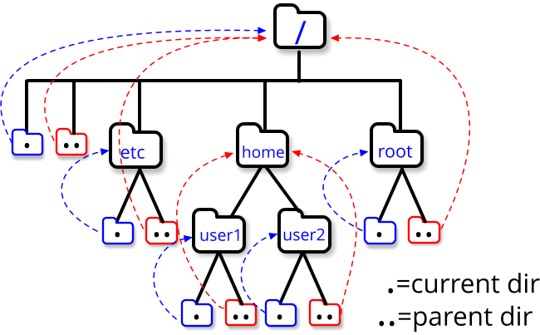
The Special Dot directories
Special dot directories
Single dot . refers to the current directory
Double dot .. refers to the parent directory
These entries exist in every directory
They allow relative navigation within the filesystem
Notes:
Every directory in the Linux file system has two special entries, with names “.” and “..”. These are shorthand ways of referring to:
“this directory”.
“the parent of this directory”.
These shorthands can be used anywhere in a pathname, relative or absolute. They are clearly of most use in relative pathnames, since they allow us to specify paths that traverse upwards through the hierarchy as well as downwards.

Slide 9
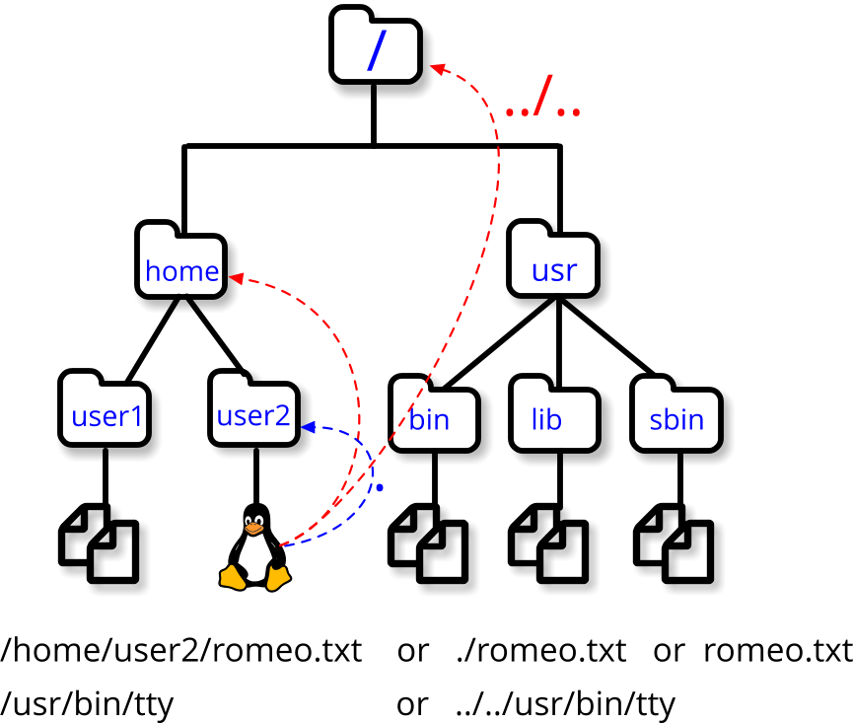
Specifying Pathnames
A pathname identifies the location of a file or directory
Path components are separated by /
Absolute paths begin with / (start from root)
Relative paths begin from the current working directory
Absolute paths Relative paths
Notes:
In this example, the current working directory is /home/user2
From this location, the relative path to /home is:
.. because .. refers to the parent directory.
Therefore, the relative path to /home/user1 is:
../user1 which means “go up one level, then down into user1”.
We can also use relative paths to refer to files in the current directory.
For example, the file romeo.txt may be written as:
./romeo.txt . refers to the current directory, so ./romeo.txt explicitly means “the file romeo.txt in this directory”.
The ./ prefix is particularly useful in two situations:
If a filename begins with a minus (-), which would otherwise be interpreted as a command option.
When running an executable file located in the current directory that is not included in the system’s PATH variable.
In those cases, ./ makes it explicit that we want to execute a file in the current directory.

Slide 10
Absolute vs. relative paths
Absolute paths
Always begin with /
Are interpreted from the root directory
Do not depend on your current location
Example: /home/qa/romeo.txt
Relative paths
Do not begin with /
Are interpreted from the current working directory
Change meaning if your location changes
Example: ./romeo.txt
Shortcuts | Meaning
~ | Current user’s home directory
~username | That user’s home directory
~+ | Current directory
~- | Previous directory
Notes:
A pathname identifies the location of a file or directory.
Absolute paths always begin with / and are interpreted from the root directory. They always refer to the same location, regardless of your current directory.
Example: /home/qa/romeo.txt
Relative paths do not begin with / and are interpreted from the current working directory. Their meaning changes depending on where you are located.
Example:. /romeo.txt
Use absolute paths when you need a precise location, and relative paths for convenient navigation within the filesystem.

Slide 11
Knowledge check
Which of these are relative or absolute paths?
/home/user1
./fred
../../etc/passwd
/var/log
country.txt
~
Notes:
Answers:
Absolute (user1’s home directory)
Relative (fred in the current directory)
Relative (up two directories then down into etc to get to passwd)
Absolute (where the log files are)
Relative (country.txt in the current directory)
Absolute (your home directory)

Slide 12
Working and Home Directories
The working directory is your current location in the filesystem
Display the current directory using pwd
Shows the full path to your current location
Each user has a home directory:
Typically /home/username
Default working directory after login
Stores the user's files and folders
Usually writable by the user
Contains user configuration files
Example
Command | Action
cd [directory] | Change to the specified directory
cd .. | Move to the parent directory
cd | Return to the user's home directory
$ pwd
/home/qa
$ cd Documents
$ pwd
/home/qa/Documents
$ cd
$ pwd
/home/qa
Notes:
The working directory is the user's current location within the filesystem. The pwd command displays the full path of the current working directory. To move between directories, use the cd command. For example, cd directory-name changes to a specified directory, cd .. moves to the parent directory, and cd returns to the user's home directory.
Every user has a home directory, typically located under /home/username. The home directory is usually the user's starting location after logging in and is used to store personal files, folders, and configuration settings. Users normally have write permission within their own home directory.

Slide 13
Listing Files and Directories
The ls command displays files and directories.
Use ls on its own to list the contents of the current directory
Command syntax:
Understanding the ls -l output:
Options | Action
-l | Long (detailed) listing
-a | Include hidden files
-C/-x | Display output in columns
-R | List subdirectories recursively
-t | Sort by modification time
-d | List directory names, not contents
ls [options] [files/directories]
$ ls -l
drwxr-xr-x | 5 | hal9000 | cyber | 168 | 2017-01-28 | 12:10 | Documents
-rw-rw-r-- | 1 | hal9000 | cyber | 677 | 2017-01-29 | 10:21 | file1
drwxr-xr-x | 2 | hal9000 | cyber | 80 | 2017-01-28 | 12:10 | public_html
-rw-r--r-- | 1 | hal9000 | cyber | 237 | 2017-01-30 | 13:22 | script1.sh
File
Type
Permissions
User
Group
Size
(bytes)
Modification
Timestamp
Name
Hard Links
Notes:
The ls command is used to display files and directories. Running ls without any options lists the contents of the current directory, while options such as -l, -a, and -R provide more detailed information. The long listing format (ls -l) shows useful details including the file type, permissions, owner, group, size, modification date, and filename.
Learning to read ls output is an important skill when navigating and managing files on a Linux system.

Slide 14

Understanding ls Colours
ls --color uses colours to identify file types:
Blue = directory
Green = executable file
Cyan = symbolic link
White/default = regular file
Colours may vary between Linux systems
ls -F appends symbols to filenames to indicate their type
Useful on terminals that do not support colour output
Example:
Color | Meaning
Uncolored (white) | File; multi-hardlink file
Bold blue | Directory
Bold cyan | Symbolic link
Bold green | Executable file
Bold red | Archive file
$ ls --color –F /home/qa
Desktop/ Music/ caesar1.txt mylink@
Documents/ Pictures/ country.txt myscript*
Notes:
Many Linux systems use colours when displaying filenames with commands such as ls --color. Colours provide a quick visual indication of the file type. Directories are usually shown in blue, symbolic links in cyan, executable files in green, and regular files in the default text colour. Different Linux distributions and terminal emulators may use slightly different colour schemes, so colours should be treated as a visual aid rather than relied upon completely.
The ls -F command adds a character to the end of each filename to indicate its type. For example, a trailing / identifies a directory, * indicates an executable file, and @ identifies a symbolic link. This provides similar information to coloured output and can be particularly useful when working on terminals that do not support colours or when output is redirected to a file. It offers a quick way to distinguish between different file types without requiring a detailed listing.

Slide 15
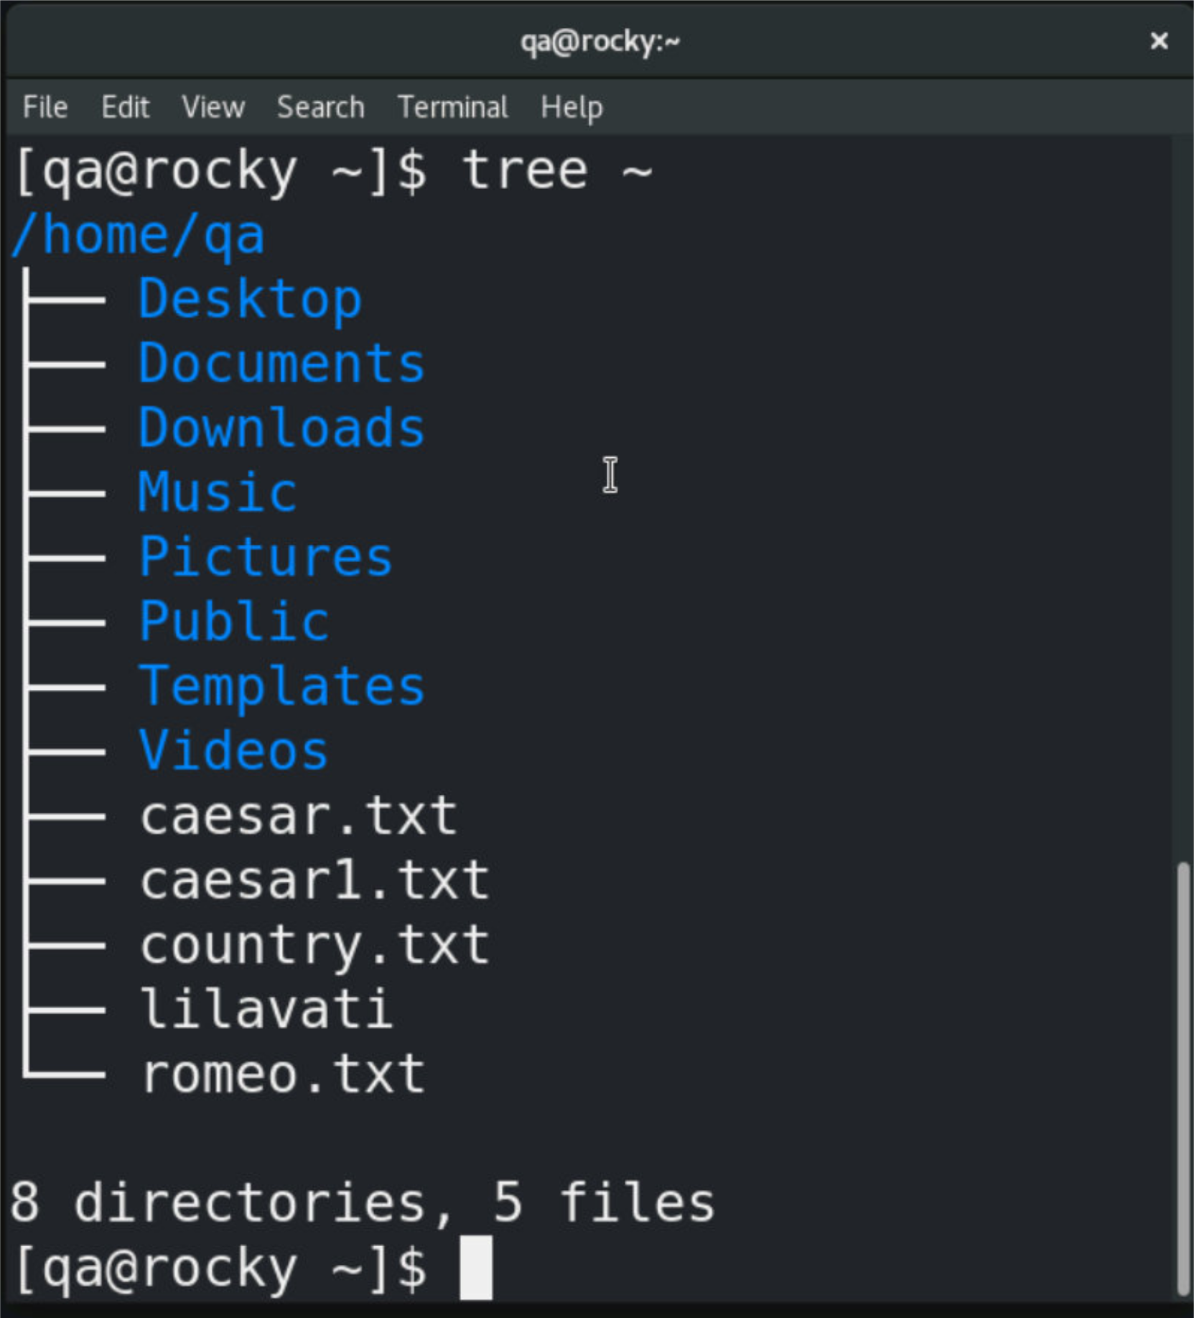
Displaying a Directory Structure
tree displays files and directories in a hierarchical format
Makes it easier to understand the structure of nested directories
May require installation before use.
Example:
Example Output:
Options | Action
-a | Include hidden files and directories
-L n | Limit output to n directory levels
-h | Display file sizes in a human-readable format
-d | Display directories only
$ tree ~
Notes:
The tree command displays files and directories in a hierarchical tree structure, making it easier to visualise how folders are organised. It is particularly useful when exploring unfamiliar systems or reviewing project layouts. Common options include -a to display hidden files and directories, -L to limit the depth of the tree, and -h to display file sizes in a human-readable format. The command is not installed by default on all Linux distributions and may need to be installed separately using the package manager.

Slide 16
Practical exercise 3 – T1 and T2
In the accompanying Exercise Guide

Slide 17
Creating Files and Directories
Create an empty file:
Create a directory:
Common mkdir options:
Examples:
Create a new file:
Create a new directory:
Create a new directory branch:
touch afilename
$ touch notes.txt
mkdir [-p|-m] [directories]
$ mkdir Documents
Option | Action
-p | Creates the directory and those in its path
-m | Sets the mode (permission)
$ mkdir -p projects/python/demo
Notes:
The touch command is commonly used to create an empty file. If the file already exists, touch updates its timestamp instead. Directories are created using the mkdir command. The -p option allows multiple levels of directories to be created in a single command and creates any missing parent directories automatically. These commands are frequently used when organising files and preparing directory structures for projects and exercises.

Slide 18
Copying Files and Directories
The cp command copies files and directories.
Common Options
Multiple source files can be copied to a directory.
Write permission is required to overwrite existing files
Examples:
Create a copy of a file:
Copy a file into a directory:
Copy an entire directory and its contents:
cp [option/s] source target
$ cp report.txt report.bak
Option | Action
-i | Prompt before overwriting
-r | Copy directories recursively
-f | Force overwrite without prompting
$ cp report.txt Documents/
$ cp -r project project_backup
Notes:
The cp command is used to create copies of files and directories. When copying a file, the destination can be a new filename or an existing directory. The -i option prompts before overwriting an existing file, while -r is required when copying directories and their contents. If multiple source files are specified, the destination must be a directory. The user must have appropriate permissions to create or overwrite files in the target location.

Slide 19
Moving and Renaming Files and Directories
The mv command moves files and directories or renames them
Command options:
If the target is a directory, the file is moved into that directory
If the target is a filename, the file is renamed
The -i option prompts before overwriting an existing file
Examples:
Rename a file
Move a file into a directory:
Prompt before overwriting
Move a directory
mv [option/s] source target
$ mv report.txt report.bak
Option | Action
-i | Interactive checking (prompts if target exists)
-f | Forced, no prompt or interaction
$ my report.txt Documents/
$ mv –i project Documents/
$ mv project project_backup
Notes:
The mv command is used to move files and directories or to rename them. When the source and target are in the same directory, the operation is effectively a rename. When the target is a different directory, the file or directory is moved to that location. Unlike cp, the mv command does not require a special option to move directories because it works recursively by default. If the target file already exists, it may be overwritten. Using the -i option prompts for confirmation before replacing an existing file, helping to prevent accidental data loss.

Slide 20
Deleting Files and Directories
Use rm to delete files
Command Options:
Use rm -r to delete directories and their contents
Use rm -i to confirm before deleting
Deleted files cannot normally be recovered
To delete an empty directory, you can use rmdir.
Examples:
Delete a file
Confirm before deleting
Delete an empty directory
Delete a directory and everything in it
rm [option/s] target
$ rm report.txt
Option | Action
-i | Prompt before deleting
-r | Delete directories recursively
-f | Force deletion without prompting
$ rm –i report.txt
$ rmdir olddir
$ rm –r project
⚠ Be careful with rm –rf there is no recyle bin
Notes:
Files are deleted using the rm (remove) command.
Write-protected files: rm prompts for confirmation before deletion.
Interactive deletion: Use the -i option to prompt for confirmation before deleting each file.
Recursive deletion: The -r (recursive) option deletes a directory and all its contents, including subdirectories.
Without -r, rm will not delete directories, even if they are empty
For example, to remove a single file – with no prompting or undo:
rm datafile
To interactively prompt before removing the file:
rm -i datafile
And to recursively remove a directory (assuming permissions will allow) and its contents:
rm –r Documents

Slide 21
Practical exercise 3 – T3 and T4
In the accompanying Exercise Guide

Slide 22
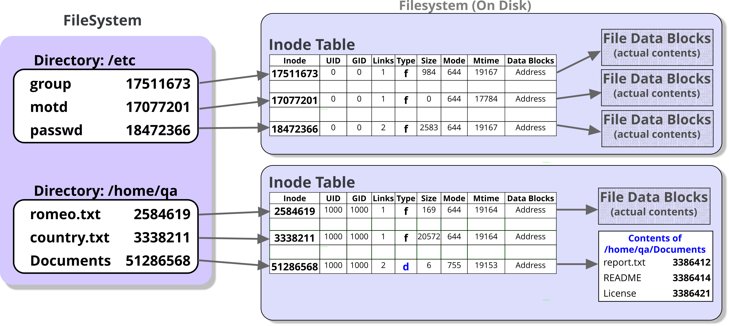
How Filenames Map to Data
Directories store filenames and inode numbers
Inodes store file metadata and data locations
File data is stored in data blocks
Multiple filenames can refer to the same inode (hard links)
Linux finds a file by resolving:
Filename → Inode → Data Blocks
Notes:
A directory does not contain the contents of files. Instead, it stores filenames together with the inode numbers that identify those files. An inode stores information about the file, such as ownership, permissions, timestamps and the locations of the file's data blocks on disk. When a user accesses a file, Linux resolves the filename through the directory, locates the inode, and then reads the associated data blocks. Because filenames and inodes are separate, multiple filenames can refer to the same inode.
This concept forms the basis of hard links, which are covered next.

Slide 23
Examining Inodes with stat and ls
Most file information is stored in the inode, not the filename
Use stat to display detailed file and inode metadata:
Use ls -li to display inode numbers in directory listings:
Inode numbers are unique within a filesystem
Hard links share the same inode number
$ stat ~/romeo.txt
File: /home/qa/romeo.txt
Size: 169 Blocks: 8 IO Blocks: 4096 regular file
Device: fd00h/64768d Inode: 2584619 Links: 1
Access: (0644/-rw-r--r--) Uid: (1000/ qa) Gid: (1000/ qa)
Access: 2022-06-24 09:40:45.000000000 +0100
Modify: 2022-06-21 18:09:57.000000000 +0100
Change: 2022-06-24 09:40:45.363800200 +0100
Birth: 2022-06-24 09:40:45.351800200 +0100
$ ls -li ~/romeo.txt
2584619 –rw-r--r--. 1 qa qa 169 Jun 21 2022 /home/qa/romeo.txt
Notes:
The inode stores most of a file's metadata, including ownership, permissions, timestamps, file size and the locations of its data blocks. The filename itself is stored separately within a directory entry. The stat command displays detailed information about a file and its inode, including the inode number and link count. The ls -li command displays inode numbers as part of a normal directory listing. Inode numbers are unique within a filesystem and provide a useful way to identify files.
When multiple filenames share the same inode number, they are hard links to the same underlying file.

Slide 24
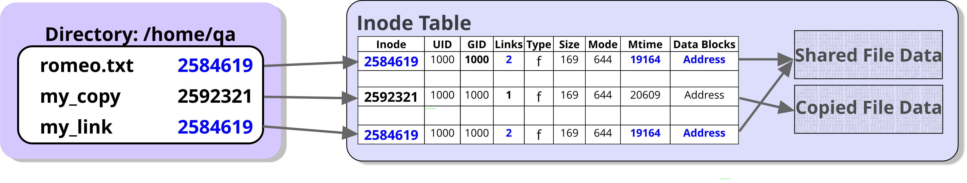
Hard links
A hard link creates another name for an existing file
Both filenames reference the same inode and data blocks
The file's data remains until the last hard link is removed
Hard links can only be created within the same filesystem.
Examples:
Notice Romeo.txt and my_link share inode 2584619
$ cp romeo.txt my_copy
$ ln romeo.txt my_link
$ ls -li romeo.txt my_copy my_link
2584619 –rw-r--r--. 2 qa qa 169 Jun 21 2022 romeo.txt
2592321 –rw-r--r--. 1 qa qa 169 Jun 5 12:18 my_copy
2584619 –rw-r--r--. 2 qa qa 169 Jun 21 2022 my_link
Notes:
A hard link creates an additional filename that refers to an existing file. Unlike a copy, a hard link does not create a second set of data blocks. Instead, both filenames point to the same inode and therefore the same file data.
In the example, romeo.txt and my_link both reference inode 2584619, while my_copy has a different inode number because it was created using the cp command. The link count for inode 2584619 is 2, indicating that two directory entries refer to the same file.
Because hard links share the same inode, changes made through either filename are immediately visible through the other. Deleting one filename does not remove the file's data as long as another hard link still exists. The file is only removed when the final hard link is deleted and the link count reaches zero.
Hard links can only be created within the same filesystem because inode numbers are unique only within a single filesystem. This limitation is one of the key differences between hard links and symbolic links, which are introduced on the next slide.

Slide 25
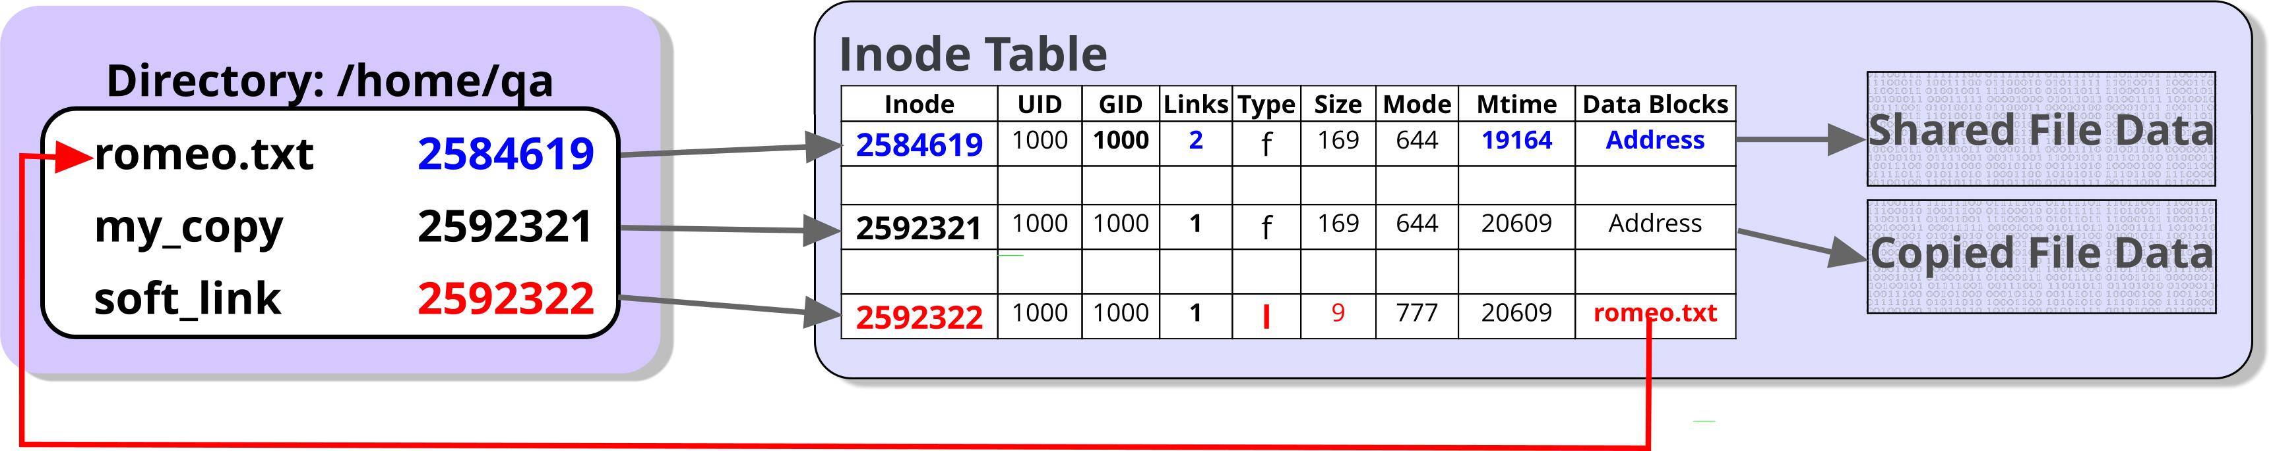
Symbolic links (soft links)
A symbolic link is a special file that stores the pathname of another file or directory
Unlike a hard link, it has its own inode and does not share data blocks
Symbolic links can reference files and directories on different filesystems
If the target is moved or deleted, the symbolic link becomes broken
$ ln -s romeo.txt soft_link
$ ls -li romeo.txt soft_link
2584619 –rw-r--r--. 2 qa qa 169 Jun 21 2022 romeo.txt
2592322 lrwxrwxrwx. 1 qa qa 9 Jun 5 12:49 softlink -> romeo.txt
Think of a symbolic link as a shortcut to another file or directory.
Notes:
A symbolic link (or soft link) is a special file that stores the pathname of another file or directory. Unlike a hard link, a symbolic link has its own inode and does not share the target file's inode or data blocks. When a symbolic link is accessed, Linux follows the stored pathname to locate the target. Because symbolic links use pathnames rather than inode references, they can point to files or directories on different filesystems. If the target file is renamed, moved, or deleted, the symbolic link remains but becomes a broken link because the stored pathname can no longer be resolved.
A symbolic link stores the pathname of its target. On many Linux filesystems, short pathnames are stored directly in the symbolic link's inode, while longer pathnames may be stored in separate data blocks.

Slide 26
Practical exercise 3 – T5
In the accompanying Exercise Guide

Slide 27
Summary
In this module you learned how to:
Navigate the Linux filesystem confidently
Work with files and directories using common Linux commands
Understand the difference between absolute and relative pathnames
Interpret directory listings and file metadata
Explain how Linux locates file data using directories, inodes and data blocks
Create and manage hard links and symbolic links

